Slide 1
Group 5 Project 1 We believe United States articles will be the most popular with the New York Times.
By: Jacob, George, David, Matt, Kenneth
Found data: NYT API

Slide 2
Motivation & Summary Slide
1) Define the core message or hypothesis of your project.
A:US news will be the most popular genre.
2) Describe the questions you asked, and why you asked them.
A: what is the most popular type of article, does that change over different timeframes, finally does that change by most emailed/shared/viewed
3) Describe whether you were able to answer these questions to your satisfaction, and briefly summarize your findings.
A: When viewing the charts and interpreting the data the charts answered our questions, they showed that the most viewed is the US articles but over time the most shared are opinion articles.

Slide 3
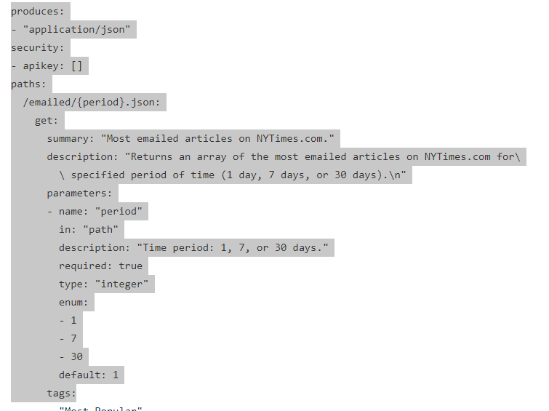
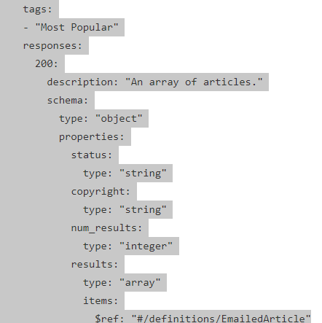
The JSON results and how to navigate the info

Slide 4
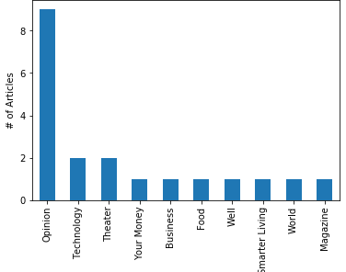
Emailed
Data Needed: 1 days of emailed articles.
Cleanup Process: Extracting relevant data points such as the article count, per section, over the given time period.

Slide 5
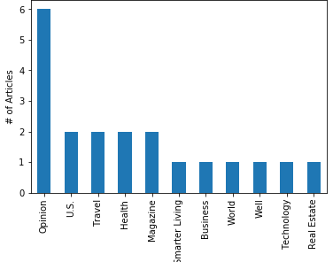
Emailed
Data Needed: 7 days of emailed articles.
Cleanup Process: Extracting relevant data points such as the article count, per section, over the given time period.

Slide 6
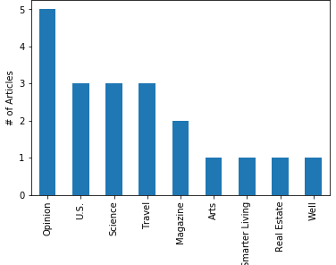
Emailed
Data Needed: 30 days of emailed articles.
Cleanup Process: Extracting relevant data points such as the article count, per section, over the given time period.

Slide 7
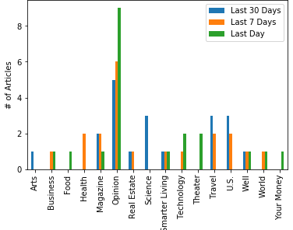
EMAILED TOTAL:
Data Needed: Combination of 1,7,and 30 days of emailed articles.
Cleanup Process: Extracting relevant data points such as the article count, per section, over the given time period.

Slide 8
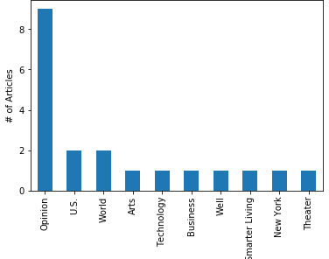
Shared
Data Needed: 1 day
Cleanup Process: Extracting relevant data points such as the article count, per section, over the given time period.

Slide 9
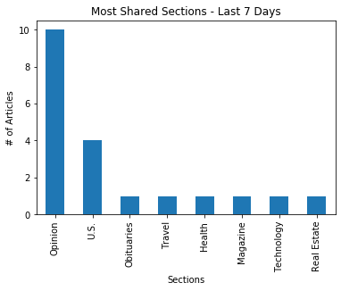
Shared
Data Needed: 7 days
Cleanup Process: Extracting relevant data points such as the article count, per section, over the given time period.

Slide 10
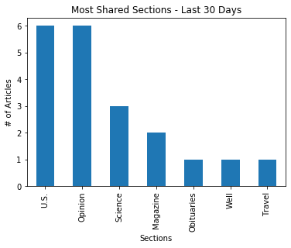
Shared
Data Needed: 30 days
Cleanup Process: Extracting relevant data points such as the article count, per section, over the given time period.

Slide 11
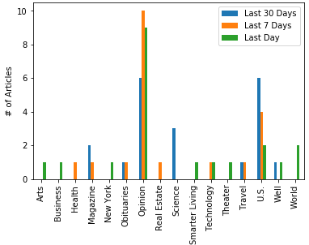
Shared Total:
Data Needed: Combination of 1,7,and 30 days of shared articles.
Cleanup Process: Extracting relevant data points such as the article count, per section, over the given time period.

Slide 12
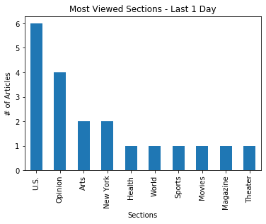
Most Viewed:
Data Needed: 1 day
Cleanup Process: Extracting relevant data points such as the article count, per section, over the given time period.

Slide 13
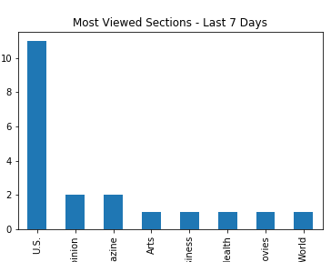
Most Viewed:
Data Needed: 7 days
Cleanup Process: Extracting relevant data points such as the article count, per section, over the given time period.

Slide 14
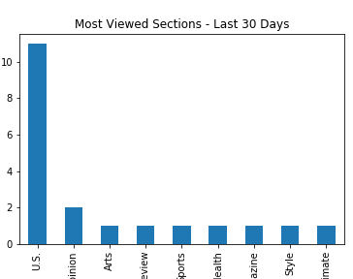
Most Viewed:
Data Needed: 30 days
Cleanup Process: Extracting relevant data points such as the article count, per section, over the given time period.

Slide 15
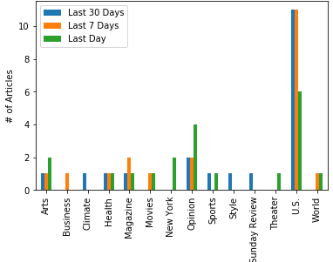
Most Viewed Total:
Data Needed: Combination of 1, 7, and 30 days of articles.
Cleanup Process: Extracting relevant data points such as the article count, per section, over the given time period.

Slide 16
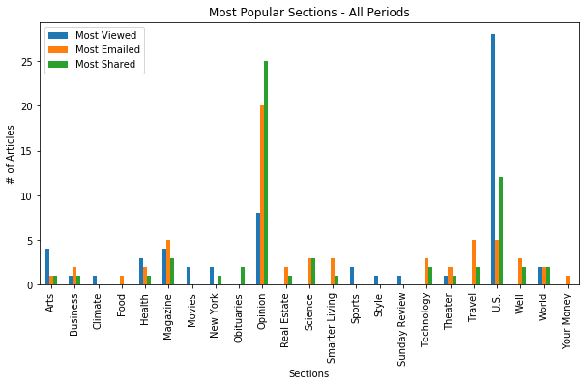
Most popular over all time periods.
Data Needed: Combination of all data. This has 1, 7, and 30 days of articles including all three primary types most viewed, most emailed, and most shared.
Cleanup Process: Extracting relevant data points such as the article count, per section, over the given time periods and combining in one graph.

Slide 17
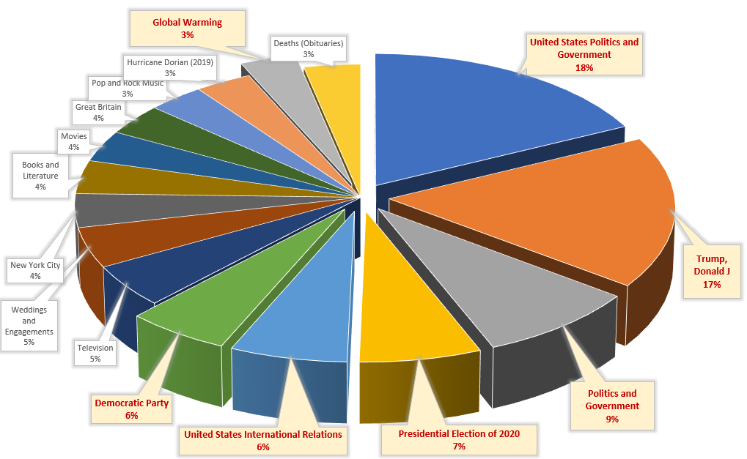
828 Articles extracted for the month of Sept.1 - Oct5.
544 Articles (66%) had 1 or more Keywords
(34%) of Articles used none
544 Articles used 1657 Unique Keywords with a total usage count of 3356
57 Keywords (3.4%) represented 50% of Keywords used
Top 25% of Percent of ALL Keyword usage is Represented by just 16 Keywords
66% of those are about U.S. Politics
Top Keyword Usage by New York Times Authors

Slide 18
Conclusions: 1) The Data 2) The Data 3) The Data

Slide 19
Thank you! Group 5 By: Jacob, George, David, Matt, Kenneth All Data was derived from: NYT API

